Slide 1
How does the North win?
Christian Spence
Economic Data Lead
Open Innovations

Slide 2
Three things …
Open collaboration
Reliable, reproducible data and analysis
Use for sound political challenge and ambition

Slide 3
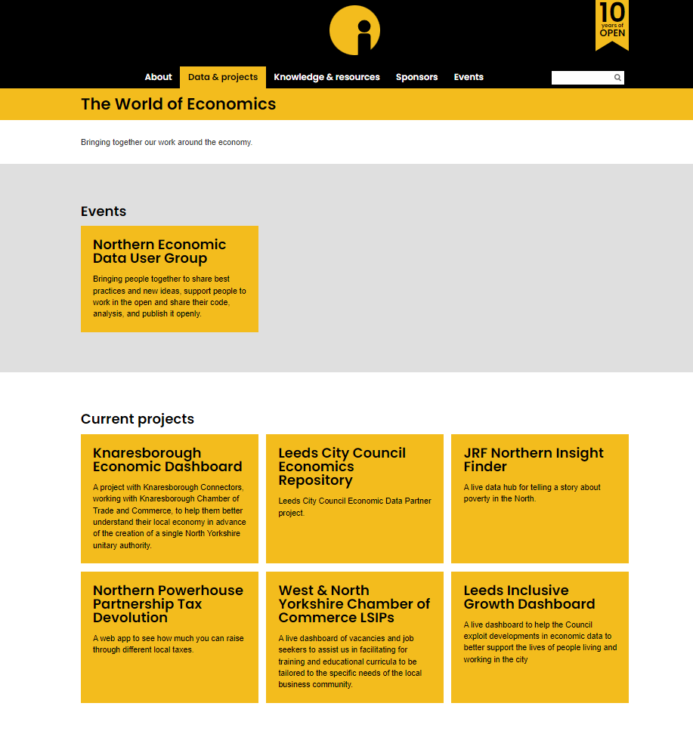

Slide 4
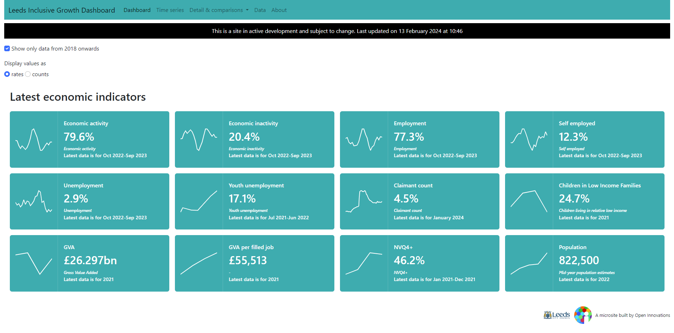

Slide 5
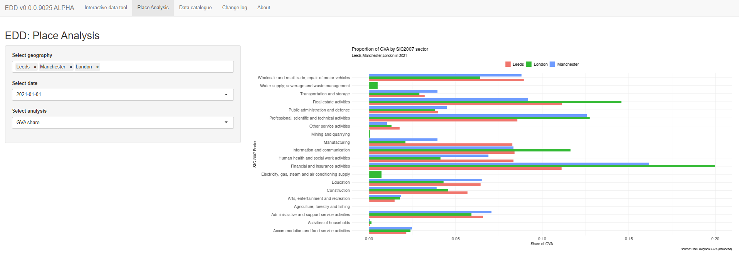

Slide 6
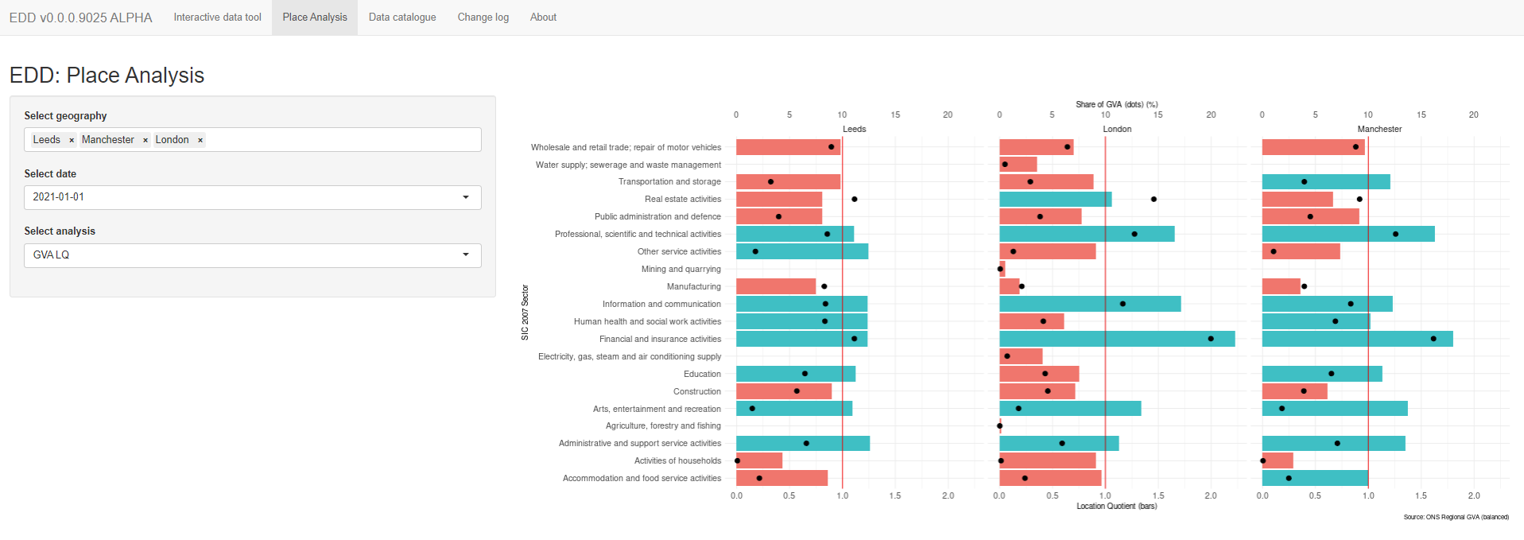

Slide 7
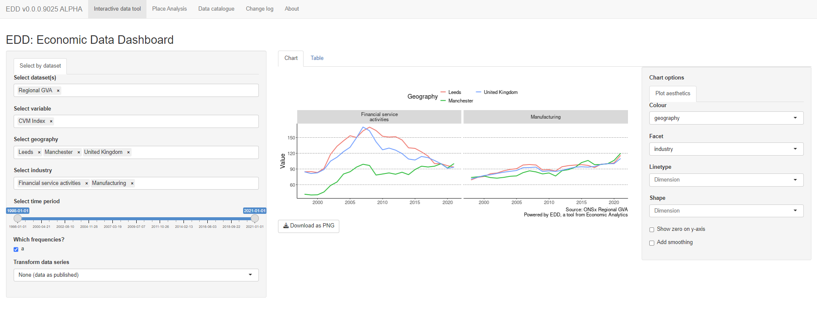

Slide 8
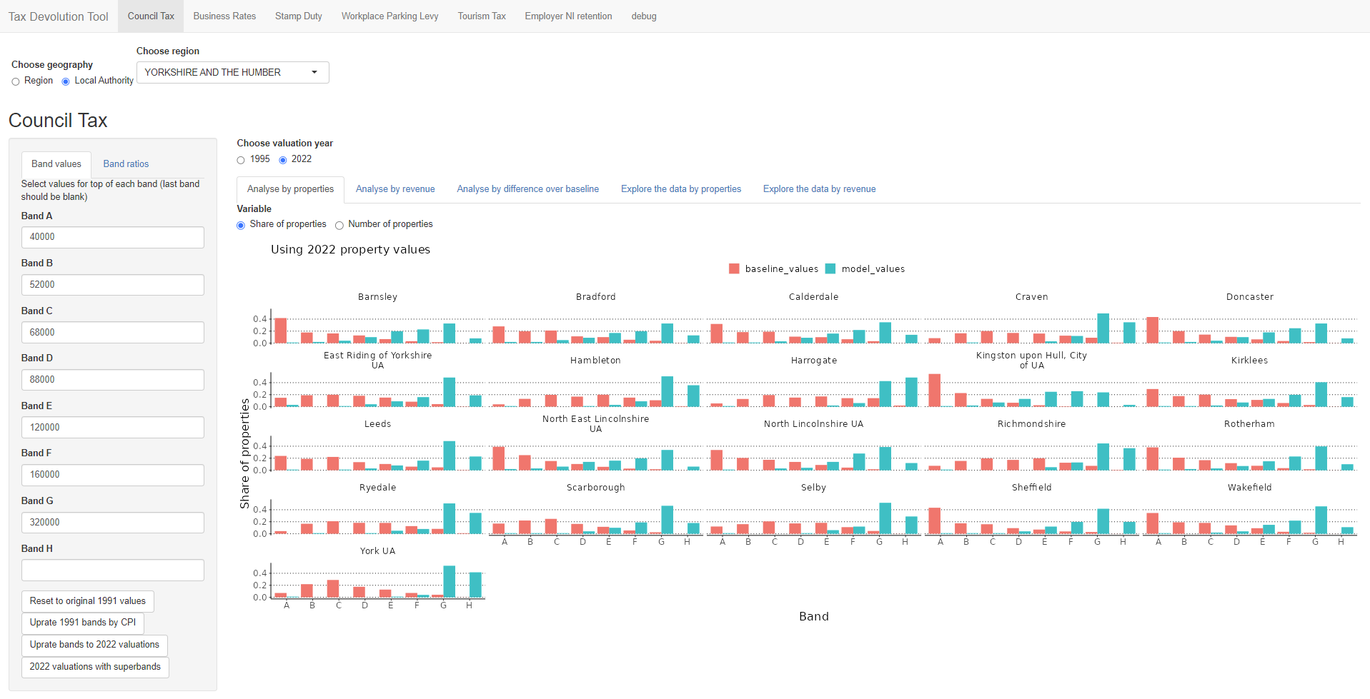

Slide 9
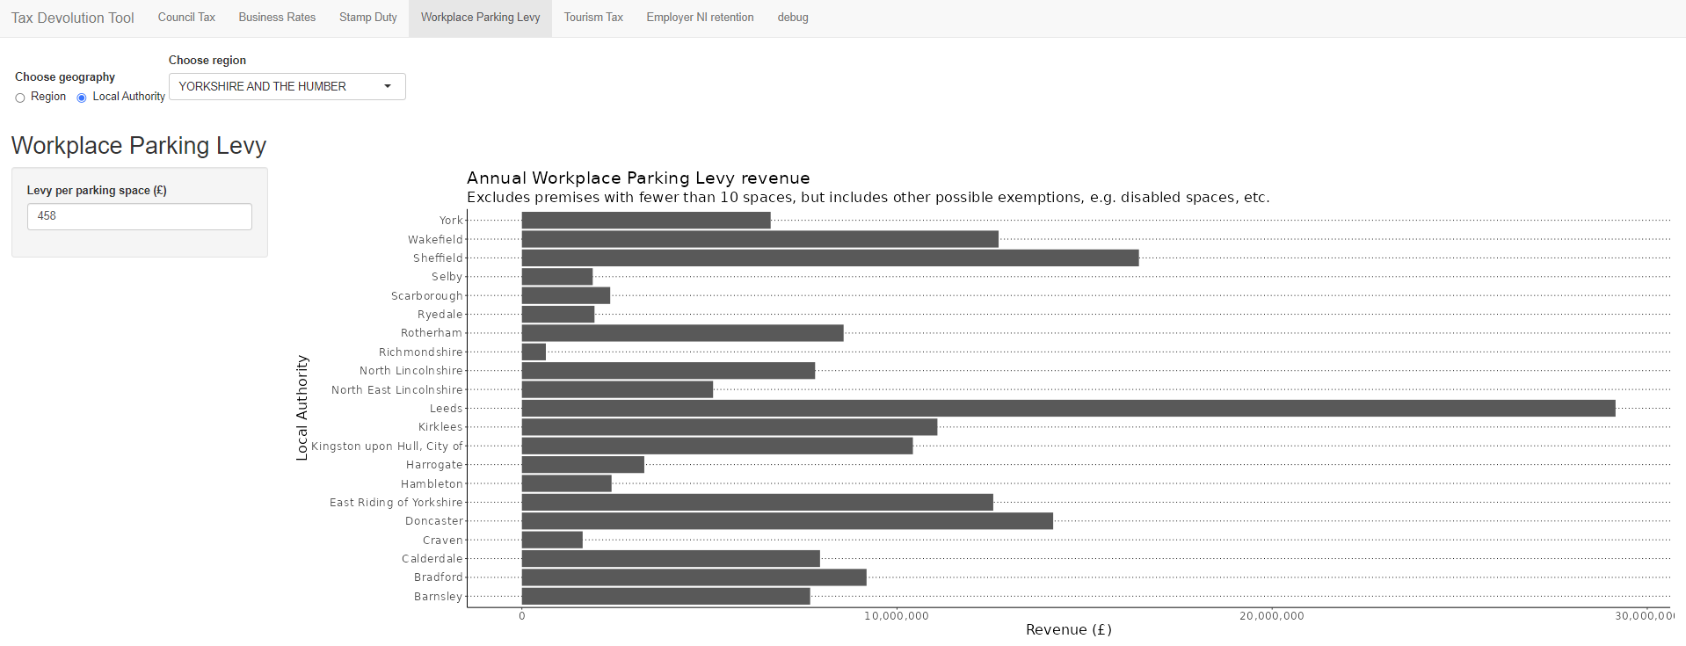

Slide 10
